Slide 1

Predicting customer buying behaviour
23/11/2023

Slide 2
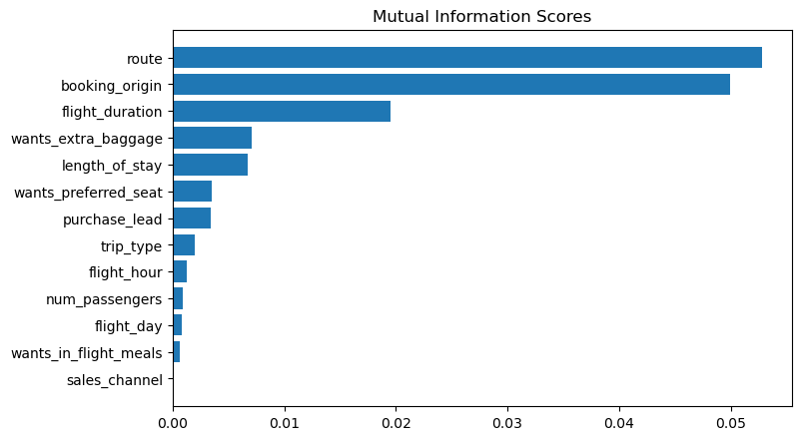
predictive model to understand factors that influence buying behaviour
MODEL ACCURACY: 83.4%
AUC score: 0.57
These are the top 5 features which influence
Customer buying behavior
Booking Origin
Route
Length of Stay
Whether they want extra baggage
Flight duration
The AUC score can be improved

